Slide 1
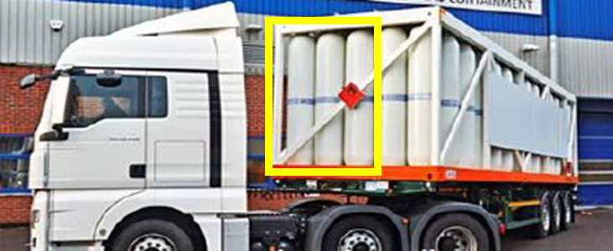
Hydrogen Transportation - Advancing Type V Technology for Efficient Sustainable Distribution
« ROAD TRHYP » ROAD trailer design – use of Type V theRmoplastic tube with light composite structure for HYdrogen transPort
2023 - 2025

Slide 2
Content
Origin of the project / Main objectives
Approach
Achievements :
Cylinder
Safety
LCA
Conclusion & Perspectives

Slide 3
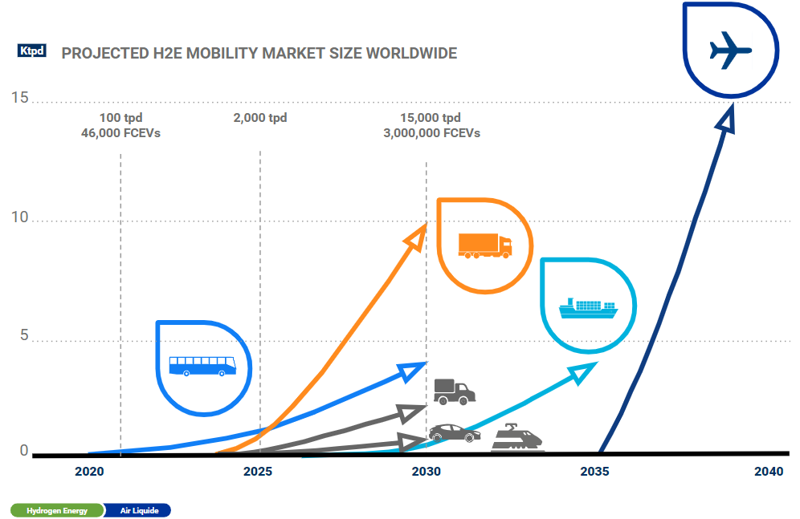
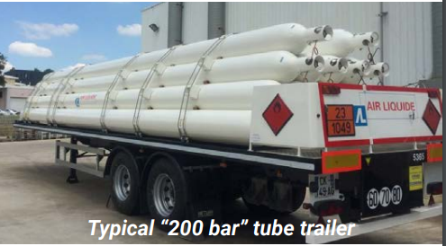
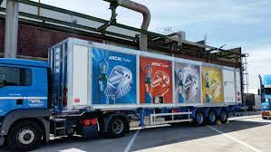
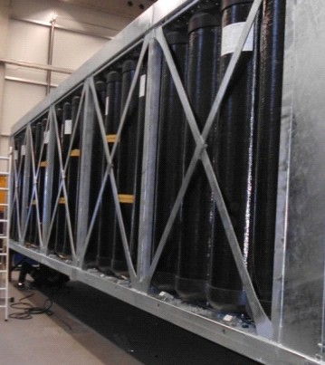
Origin of the project
300 bar tube trailer
300 kg gH₂
900 kg gH₂
1,5 T gH₂
Main objectives
Design Type V tubes according to EN17339
Elaborate a decontamination methodology to ensure H₂ purity
Demonstrate the safety of Type V tubes
Demonstrate that a trailer made with Type V tubes will achieve 700 bar, 400 €/kg H₂, 5,3 % H₂ & improved environmental impact
Regulations aiming at faster deployment of the technology

Slide 4
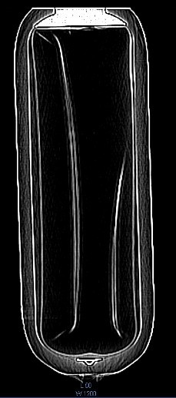
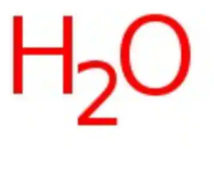
Approach and Objectives
Approach : design of MEGC based on a safety basis, develop the optimum composite cylinder to meet the max load on the road
Optimum cylinder Working Pressure to meet the 1,5 T in a gH₂ trailer
Complying with usages
To be able to dry / decontaminate the cylinder & trailer
Collapse & Blister resistant
To be compatible with gH₂
5 ppm + ISO 14687

Slide 5
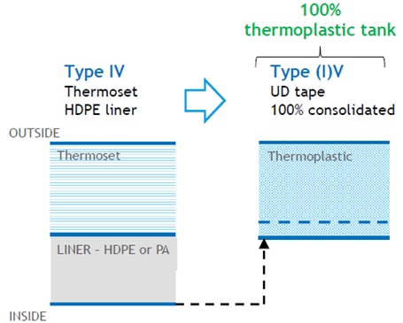
High performance cylinder : Type V
Develop a thermoplastic composite cylinder with a monolithic structure C/PA11^{(*)}
Monolithic cylinder structure :
- less assembly arrangement compared to Type IV
- the ability to do vacuum and improved drying / decontamination (DoE)
- increase the inner cylinder volume
Cylinder design :
- dome designed to remove most of liquid water after cylinder pressure test
Recyclability :
- 100 % recyclable
^{(*)} PA11 100% biosourced

Slide 6
Operate the cylinder in Europe & Comply with safety requirements
Regulations are mandatory / Standards are voluntary.
Regulations are international and declined by country.
Standards :
Ancillary components
Gas cylinders
Regulations :
Dangerous goods: international
Pressurized gas transportation: national
Road vehicle weight & dimensions: national
Standards on transportable gas cylinder
Hydrogen cylinders & ancillary components
Regulations :
Environment protection : national
Standards :
HRS design
Hydrogen refuelling station
Transportation
Notes:
Faire prendre conscience que c’est pas simple et que les législations soient un match pour tous les pays européens.

Slide 7
Trailer Safety Analysis
3 main accidental scenarios feared, leading to release of hydrogen : hose rupture, leakage on filling hose or pipings
Case no mitigation system is implemented : assessment of the severity of H₂ flammable cloud ignition consequences (jet fire, explosion) → use of simple engineering models
CFD simulations planned in 2024 for
evaluation of the safety barriers

Slide 8
Life Cycle Analysis

Slide 9
Conclusion & Perspectives
Trailer Design to optimise tube working pressure to maximise the amount of gH₂ in the trailer
Promising performances of Thermoplastic Type V cylinder (usages, performances)
Compliance with European regulation, Codes and Standards
Design to safety approach
Next to come :
Key performance tests for cylinders
Finalise trailer design → Working Pressure
Tank comportment in a hostile environment : fire
Key usage tests : decontamination & filling/unfilling
LCA : Type V trailer

Slide 11
T5.3: Laboratory scale: mechanical behaviour of tanks exposed to fire
Main objectives of this task are to :
A/ Perform lab scale tests
On samples cut or manufactured by COVESS
To determine the mechanical behaviour at different temperatures and after fire exposure
B/ Evaluate the inputs of different thermomechanical models
Together with pyrolysis models from WP2
To predicting variation of stiffness and strength of the composite material with temperature
C/ Simulate the time-to-burst of a set of tubes representative of a module in a fire
[M16-M36]
Task leader: PPRIME
Participants: COVESS, EFECTIS

